Slide 1
Introduction
Project done by:
M. Ramya
V. Manohar Chary
K. Rami Reddy

Slide 2
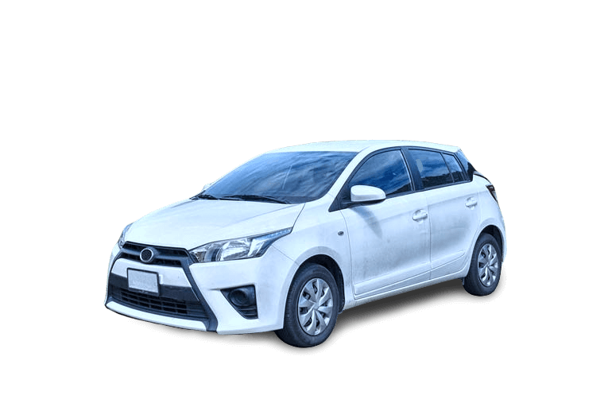
CAR TRADE
Web Scrapping with EDA

Slide 3

Car Trade

Slide 4



Slide 5
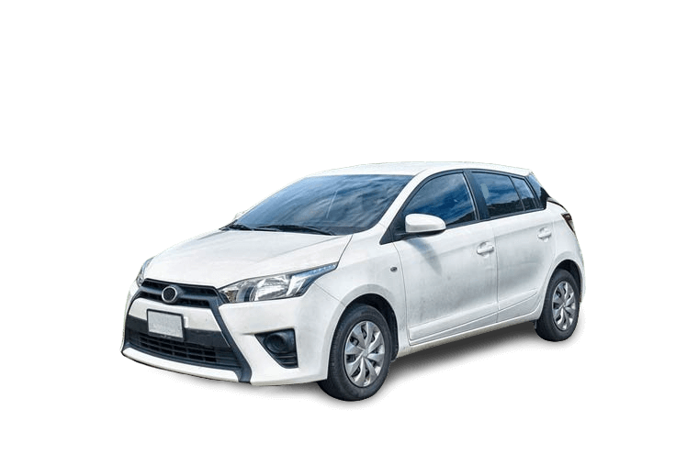
Problem Statement:
People already have access to their own personal big data, but do not make use of it.
We want to change this and give people the tools to find insights in their message history and known him/herself better.
Finding the best car in our Budget.

Slide 6
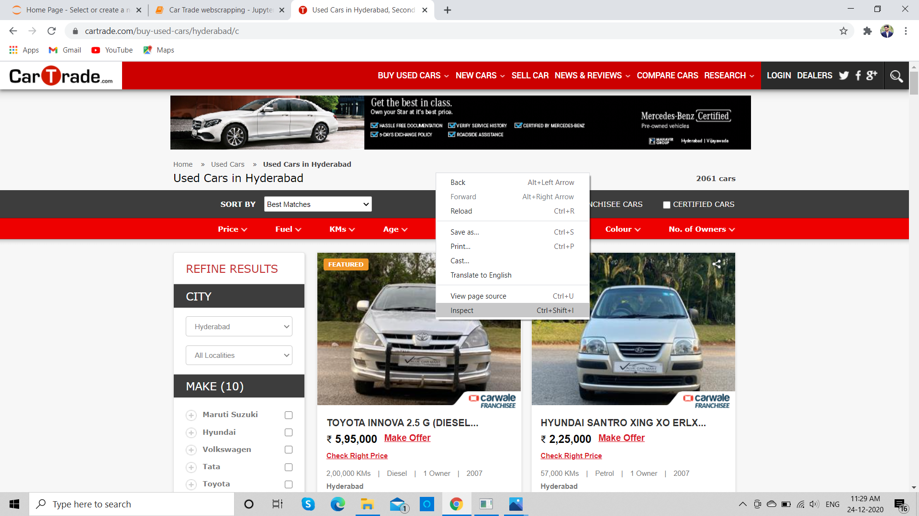
Inspecting the Car Trade Website

Slide 7
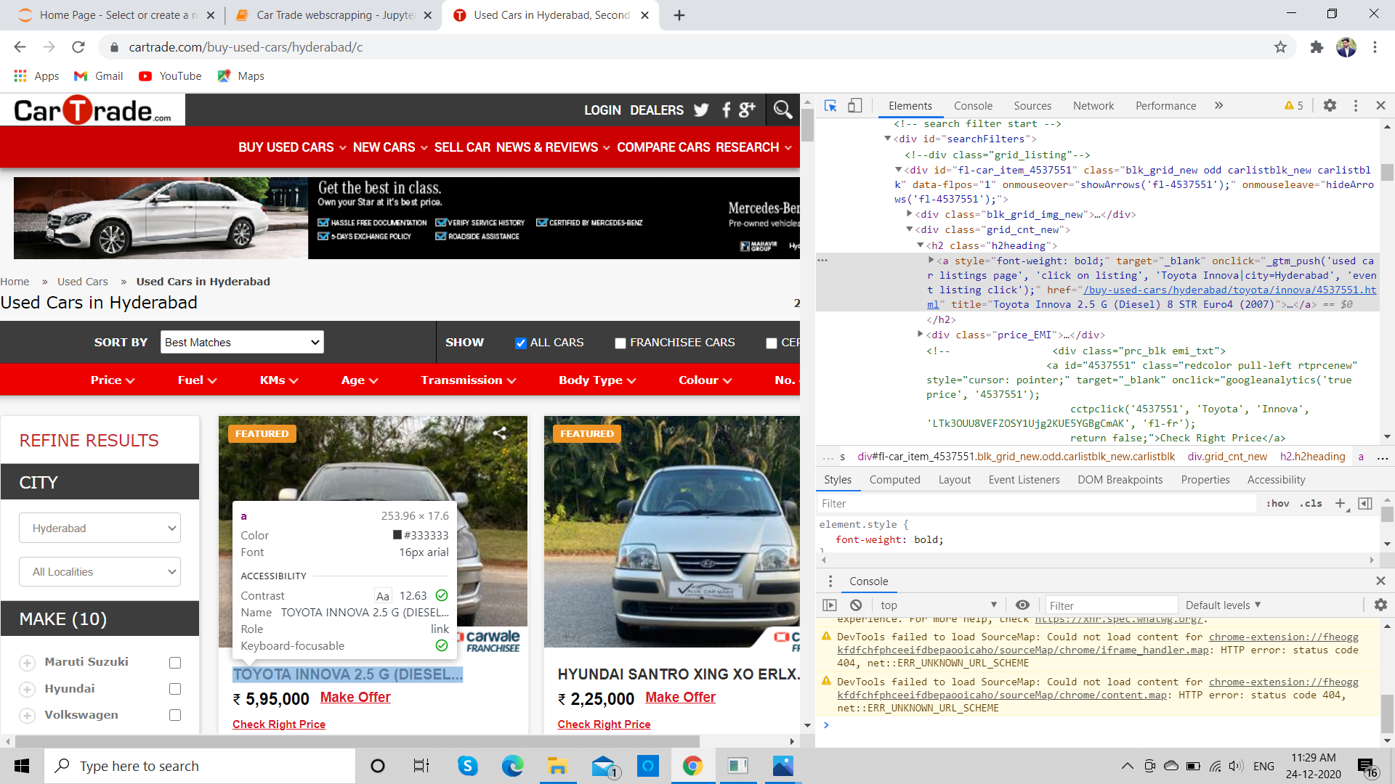
Extracting the HTML Tag for required elements

Slide 8
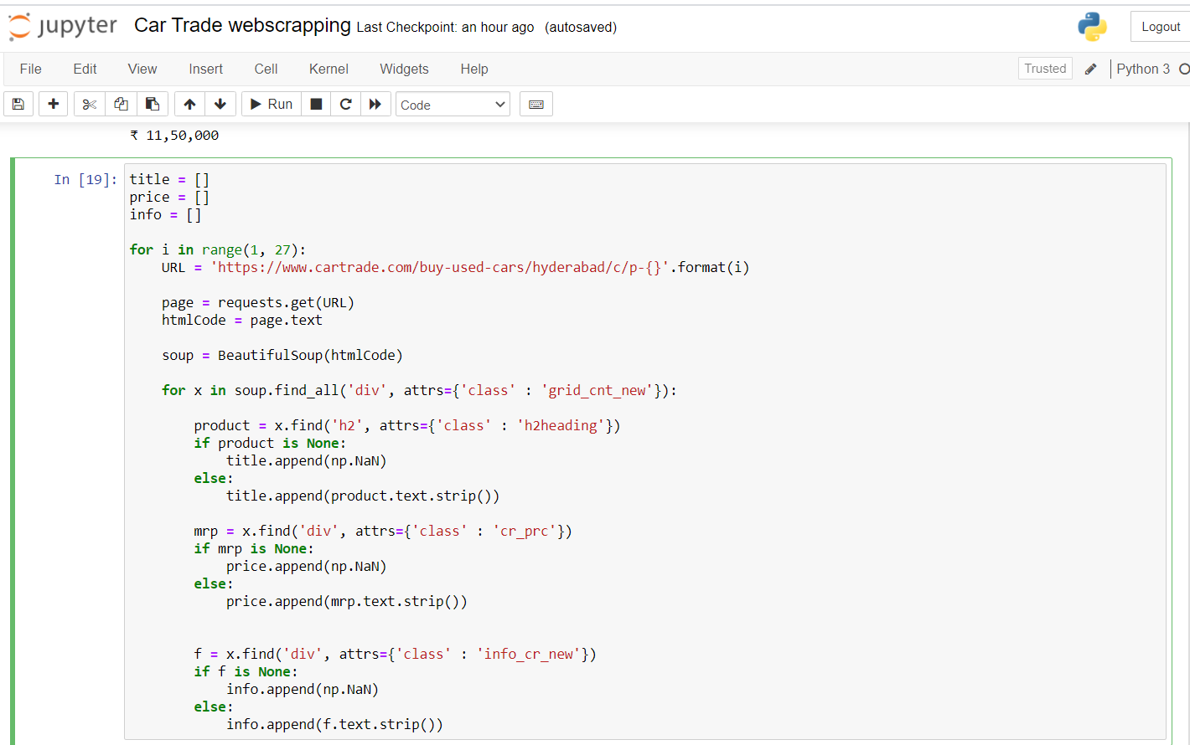
Code to Scrap the Data

Slide 9
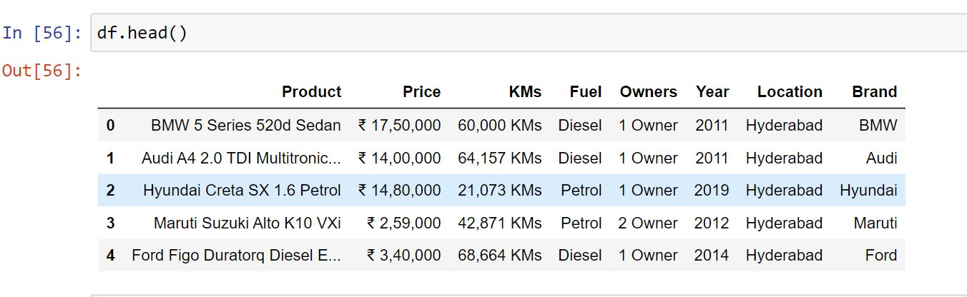
Converting Data Frame to CSV

Slide 10

CAR TRADE

Slide 11
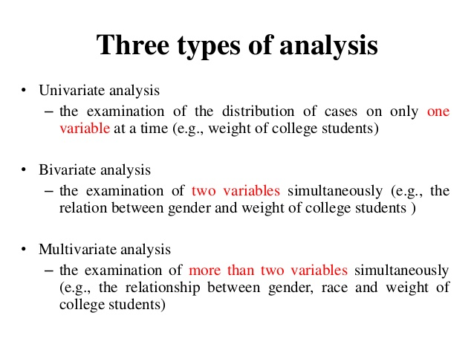

Slide 12
Univariate Analysis:
“Uni” means “one”, so in other words your data has only one variable.
It takes data, summarizes that data and finds patterns in the data.
1.Displot
2.Count Plot
3.ECDF (Empirical Cumulative Distribution Function) Plot

Slide 13
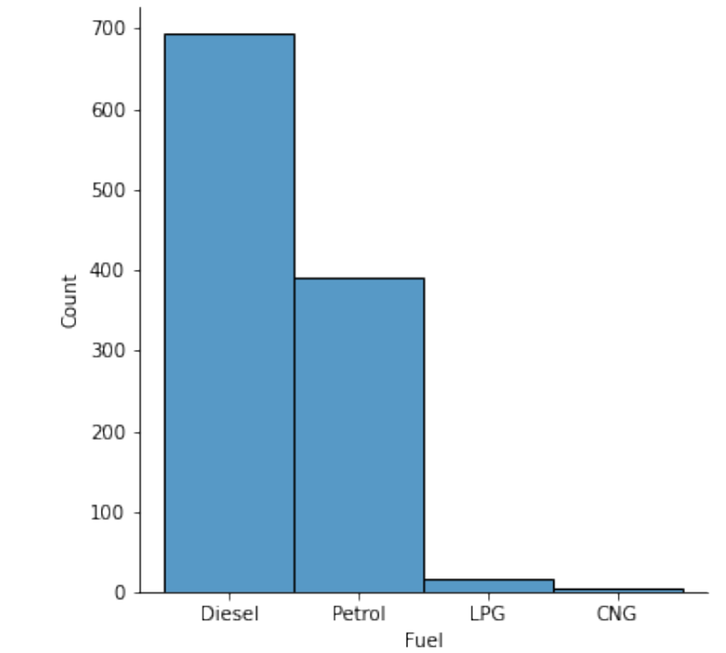
Displot
Represents the variation in the data distribution.
Visualize of distribution of data sets.
Categorical Variable
Observation:
From the data we observe that Diesel used cars are more than the Petrol, LPG, CNG used cars.

Slide 14
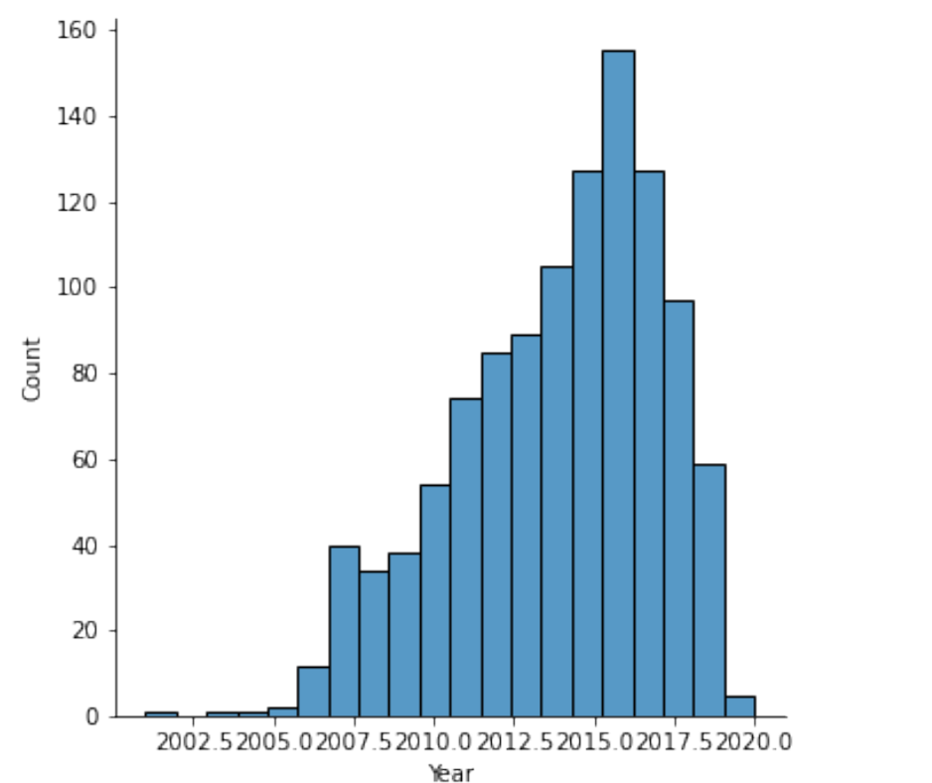
Displot
Numerical Variable
Observations:
From the data we observe that maximum Cars are in year from 2015 to 2017.year cars
Least number of cars are in year from 2002 to 2005.

Slide 15
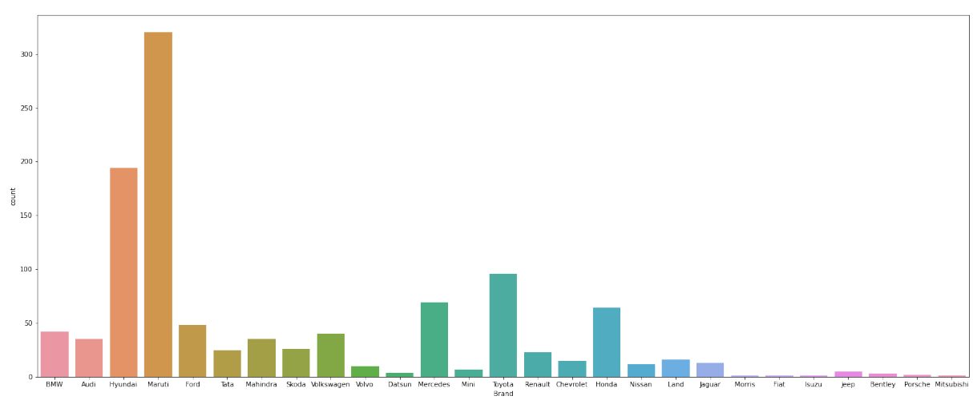
Count Plot:
It shows The number of occurrences of an item based on a certain type of category.
Observation:
From the data we observe that Maximum number of cars from Maruti Brand.
Morris , Isuzu , Mitsubishi Brand cars are least.

Slide 16
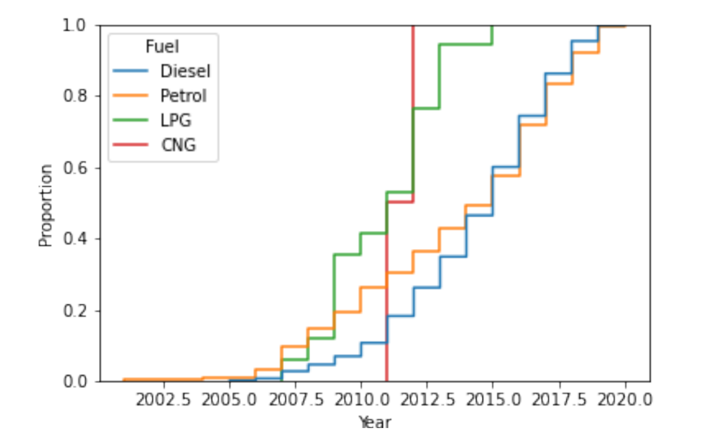
ECDF Plot (Empirical Cumulative Distribution Function)
It represents the proportion or count of observations falling below each unique value in a dataset.
Observations :
We are comparing Fuel with Year.
From the data we observe that Petrol used cars are starting from the year 2001 to 2020.
Diesel used cars starting from the year 2005 to 2020.
LPG used cars starting from 2007 to 2014 year.
CNG used cars starting from 2011 to 2012.

Slide 17
Bivariate Analysis
Bivariate analysis means the analysis of bivariate data.
It is the analysis of exactly two variables.
Box Plot
Hist Plot
Violin Plot
Cat Plot
Bar Plot
Boxen Plot

Slide 18
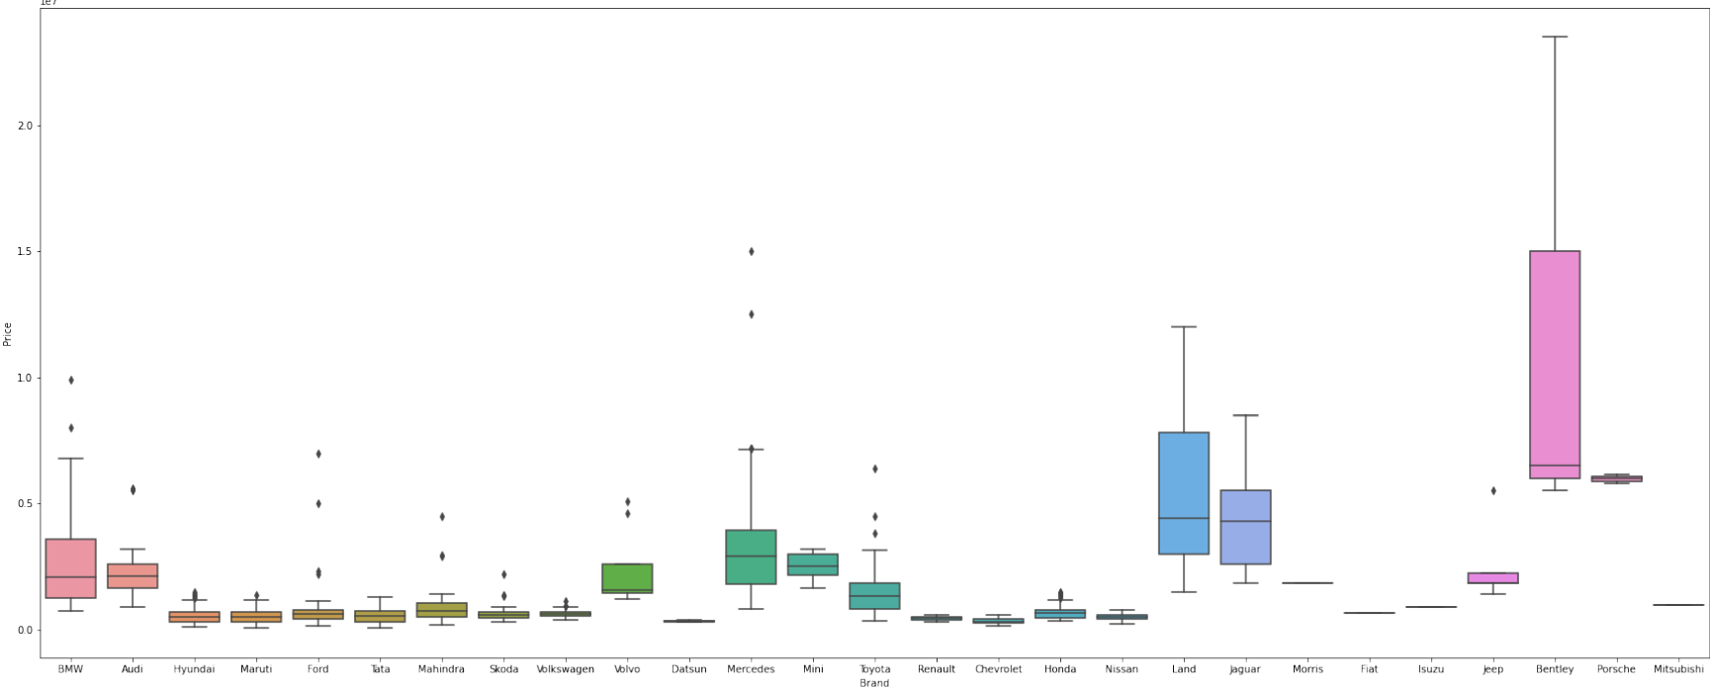
Box Plot
Observation:
From the data we observe that Bentley car has highest price.
The cheapest cars are Ford , Maruti, Hyundai.

Slide 19
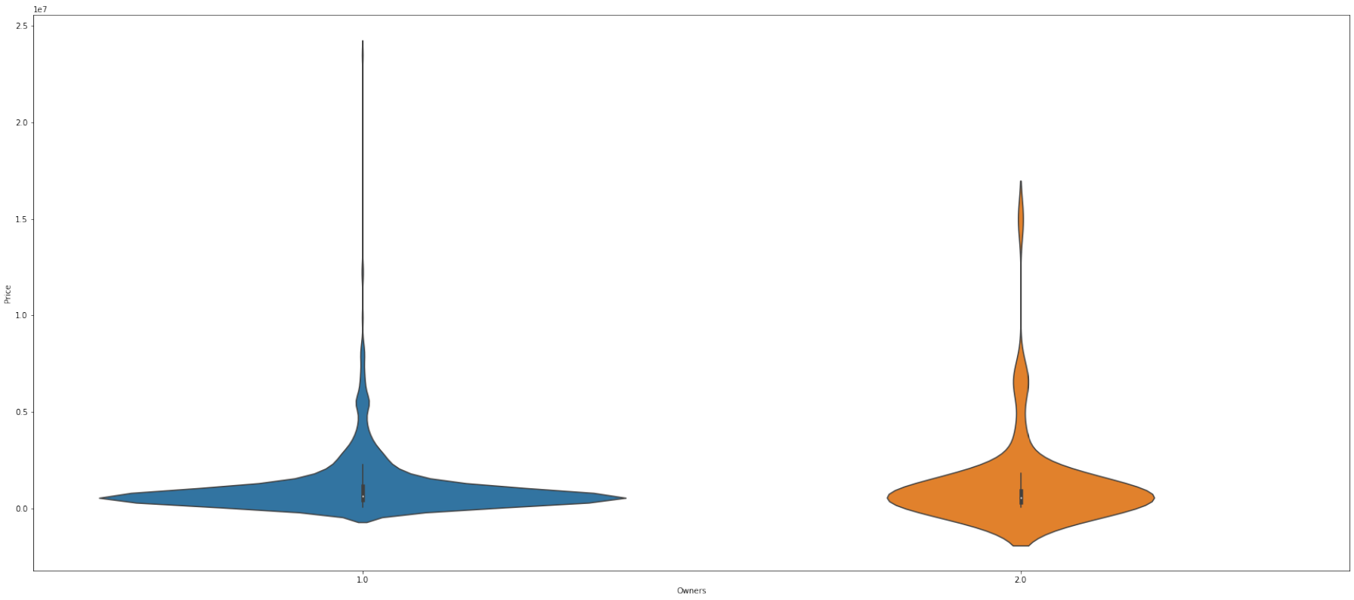
Violin Plot
Observation:
The Vehicles used by single owner are more and at the Same time the median price of the vehicles used by only single owners around 10 lakhs

Slide 20
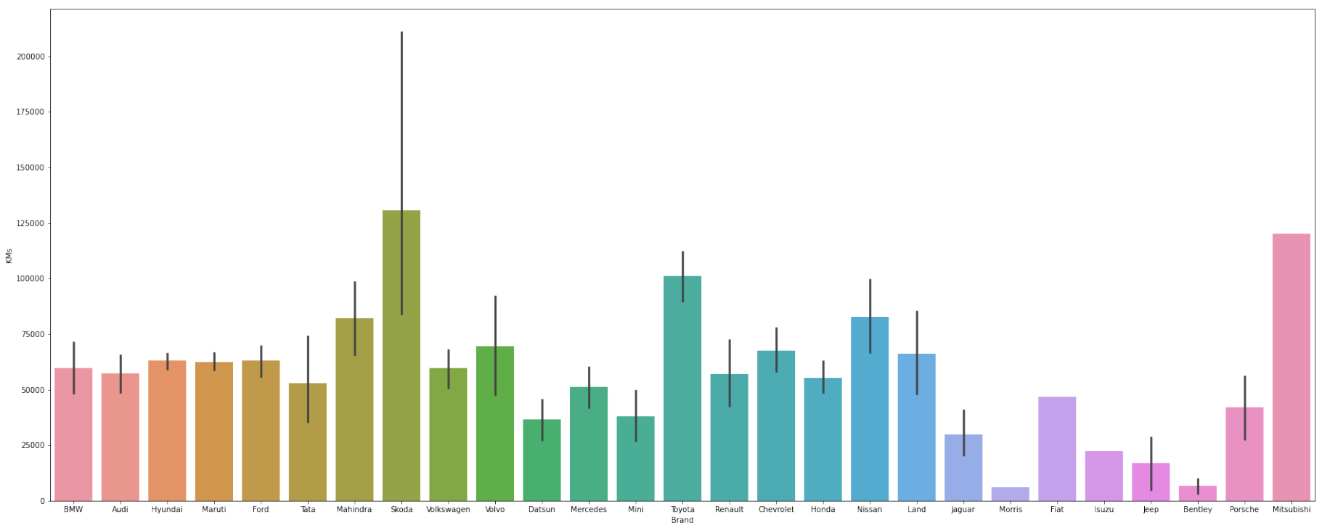
Bar Plot
Observation:
From the data we observe that Maximum KMs cars are from Skoda.
Minimum KMs cars are from Morris.

Slide 21
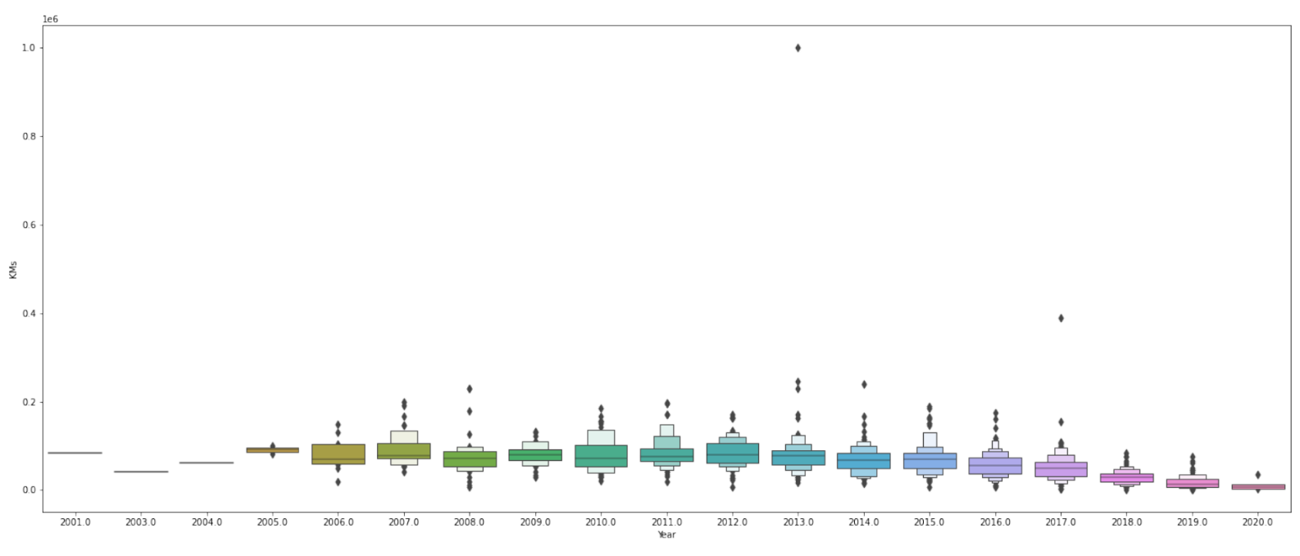
Boxen Plot
Observation:
From this data we observe that cars had travelled highest kilometers in 2013 and least in 2020

Slide 22
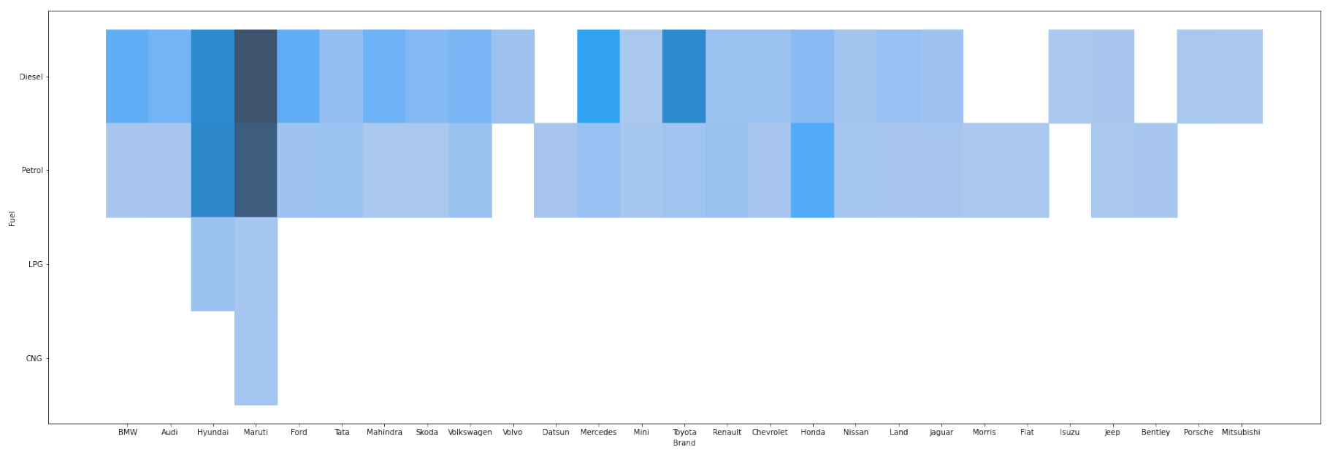
Hist Plot
Observation:
From the data we observe that the four Fuels (Petrol , Diesel , LPG , CNG )
used cars available from Maruti Brand.
Petrol , LPG , CNG used cars are available from Hyundai Brand.
The remaining Brand cars used only Petrol , Diesel.
Datsun, Morris, Bentley are non Diesel Cars(Only used Petrol).
Volvo, Isuzu cars are only used Diesel.

Slide 23
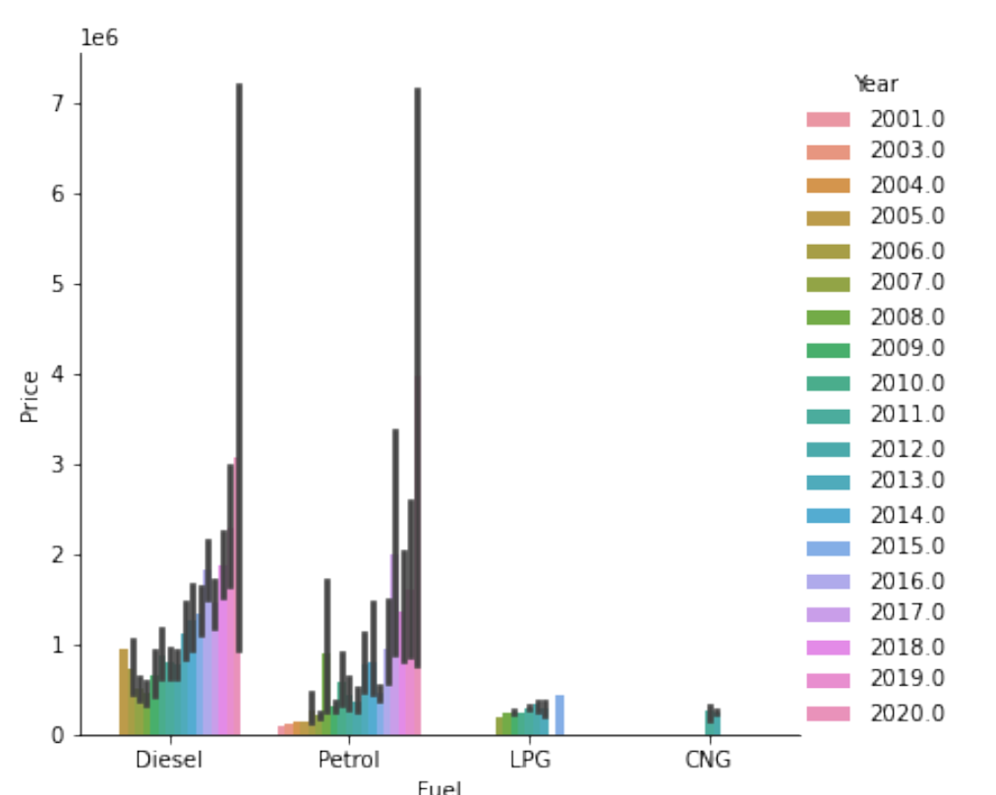
Cat Plot
Observation:
From this data we observe that LPG and CNG used cars have least prices(1 lakh to 5 lakh).

Slide 24
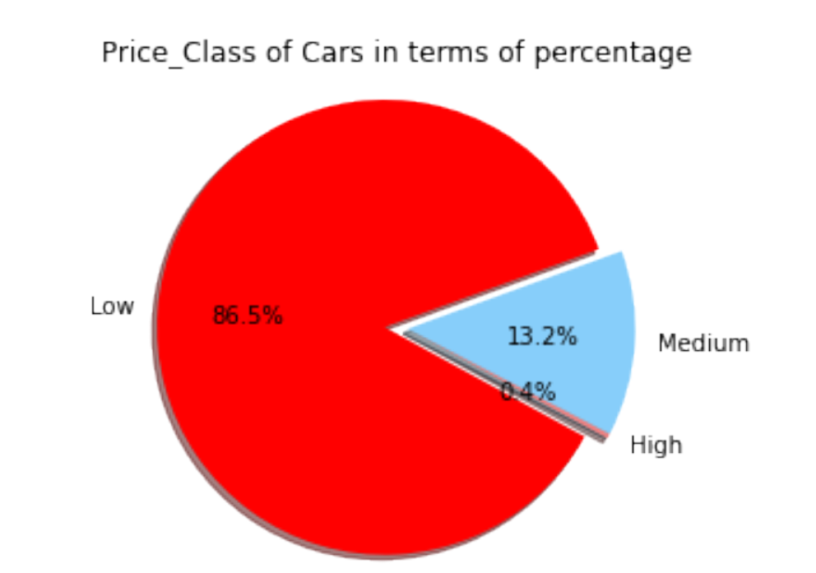
Pie Chart
Observation:
From this data we observe that Low price cars are higher than the Medium and High cars.
Low price cars :- Below 20,00,000
High price cars :- Above 1 Crore

Slide 25
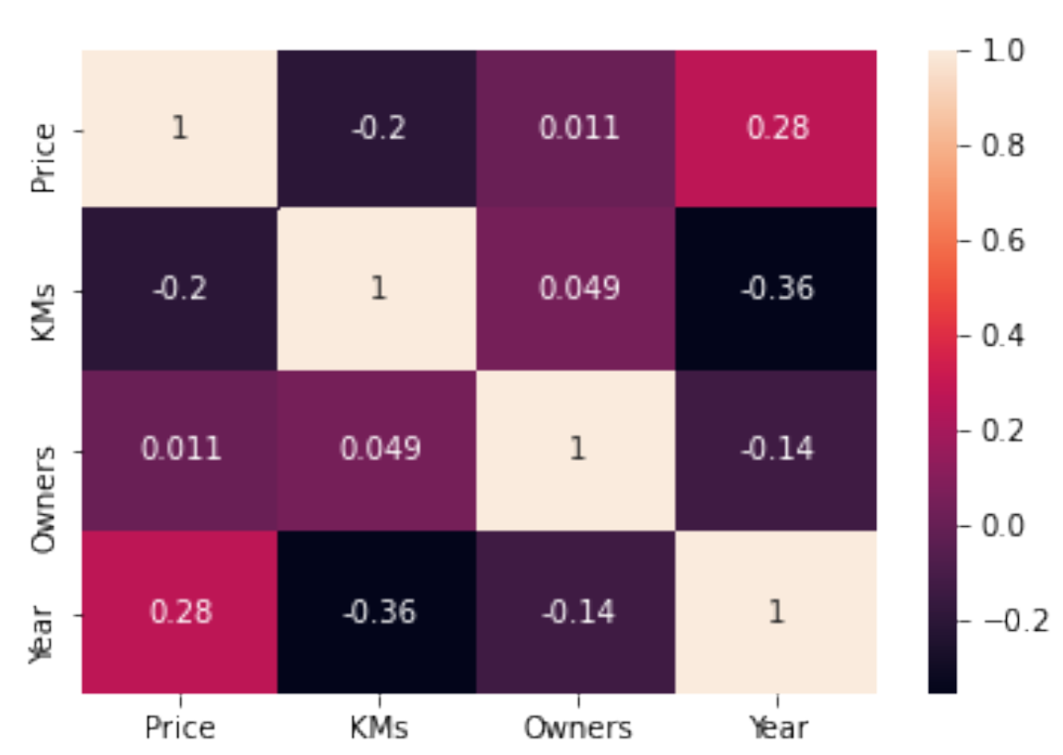
Heatmap
Observation:
From the correlation the above heat map it can be observed that Years used to have a major influence on the price so Price is a dependent variable on a life of the used cars.

Slide 26


Slide 27


